Slide 1

ARISE

Slide 2
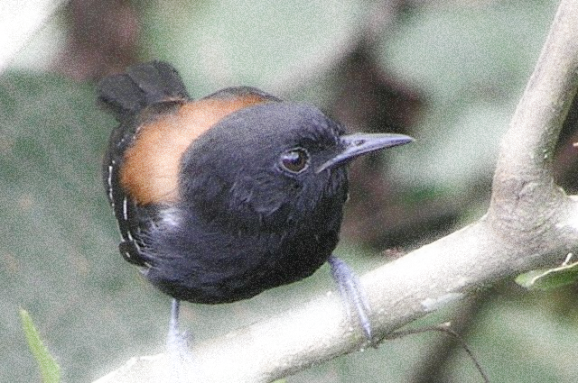
AVES
DO
BRAZIL

Slide 3
CSOI

Slide 4
CCB

Slide 5
D
B
DIABETES BRAZIL

Slide 6
H
H
+
São Paulo

Slide 7

HRC

Slide 8
Stay
Pumped

Slide 9
✵
up

Slide 10
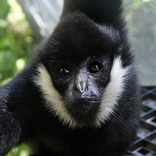
wwsm
rescue

